Slide 1
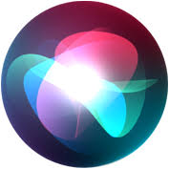
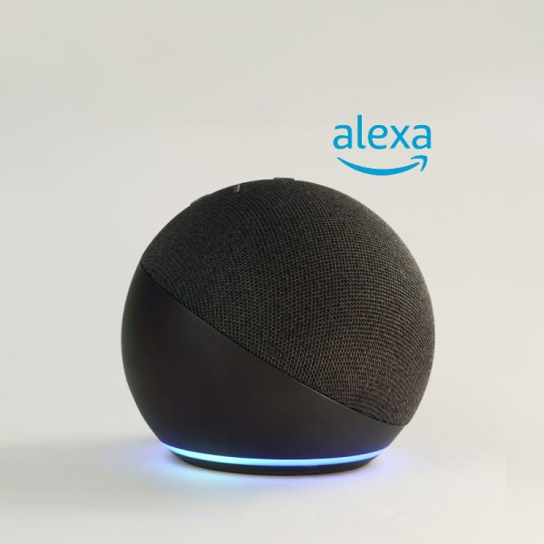
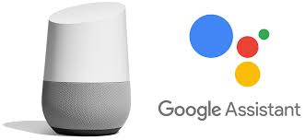
Adjust your assistant
Name: Lior Gabbay
Id: 208197327
Project type: application

Slide 2
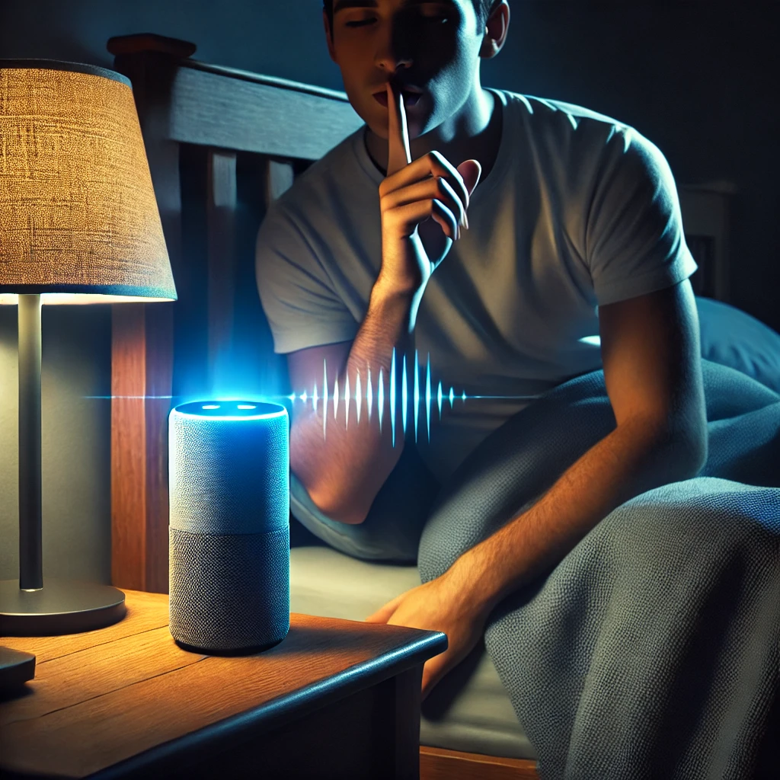
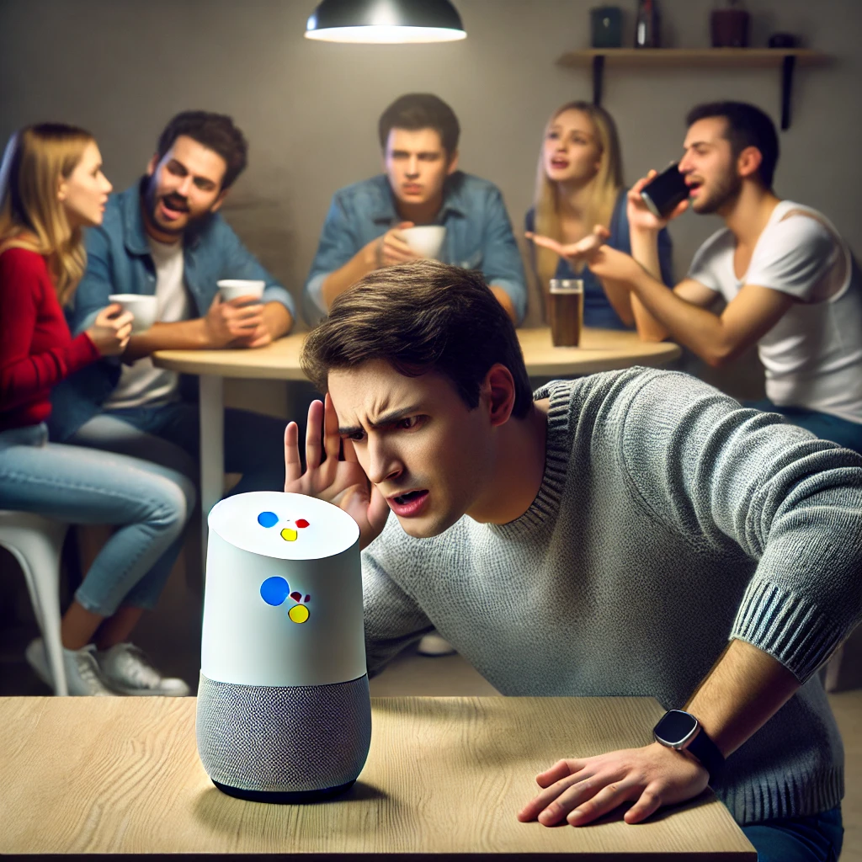
My project choice

Slide 3

Project flow
Pre – process existing data
Model training on existing data
Pre-process
Prediction
User recording
Text To Speech (google Api)
Assistant Response
Speech to Text
Getting response (Chat gpt)

Slide 4
Data
My data
Pre - process
1
150 whisper/quiet talking records
1
Load audio as his original sample rate
2
150 regular talking records
2
Computes the MFCCs from the audio
3
150 loud talking records
3
Calculates the spectral contrast
Total of 450 records
3
compute the mean of the features
40 columns of MFCC, 7 Columns of Contrast
Example of the table after pre - process
Audio File | MFCC_1_mean | MFCC_2_mean | ... | MFCC_40_mean | Contrast_1_mean | ... | Contrast_7_mean
File1.wav | -350.23 | 150.45 | ... | 0.55 | 20.65 | ... | 18.55

Slide 5
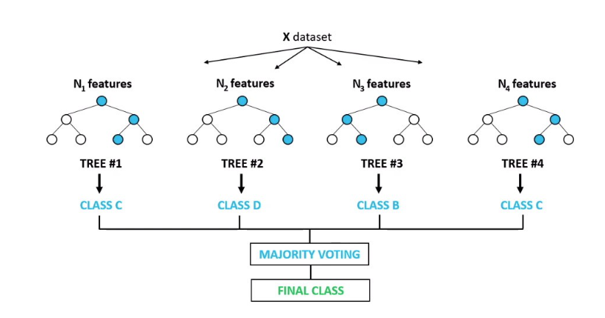
Machine learning model – random forest
Random Forest
A random forest is a machine learning model that consists of a large number of individual decision trees that operate as an ensemble. Each individual tree in the random forest give a class prediction, and the class with the most votes becomes the model's prediction.
Each tree in a random forest is built independently by selecting a random subset of features to look at, which helps in creating diverse trees that collectively enhance the model's ability to generalize well on unseen data.
I chose Random forest with 100 estimators [trees]

Slide 6
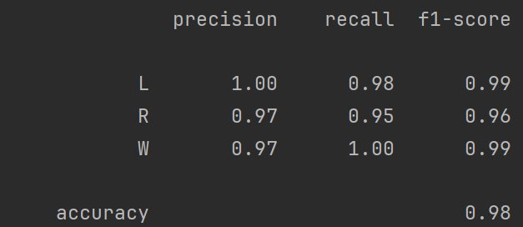
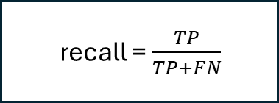
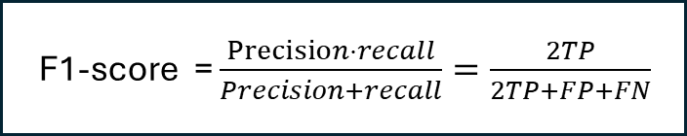
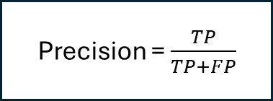
Model result on test set
Precision = $\frac{TP}{TP+FP}$
F1-score = $\frac{Precision⋅recall}{Precision+recall}=\frac{2TP}{2TP+FP+FN}$
recall = $\frac{TP}{TP+FN}$

Slide 7

demonstration

Slide 8
Links
OpenAI – speechTotext, ChatGPT (https://openai.com/chatgpt/).
Google API – textToSpeech (https://cloud.google.com/text-to-speech?hl=en)
ChatGPT – (https://chatgpt.com/)
Want to try? [link to my project on GitHub] : MirrorTalk

